Slide 1

DAYANANDA SAGAR COLLEGE OF ENGINEERING, BANAGLORE HACKMEGA – UNO 2023
TEAM NAME --- TEAM PHANTOM
TEAM MEMBERS --- SURAJ MUKHERJEE (2ND YEAR, EEE)
PRAKRATI BAJPAI (2ND YEAR, EEE) SURESH KUMAR CHOUDHARY (2ND YEAR, EEE)
SYED ZOHAIR AMMAR (2ND YEAR, EEE)
DOMAIN --- CIRCUIT(EMBEDDED system)

Slide 2
Embedded system Problem statement
Developing an embedded system for detecting and analysing structural integrity of bridges and buildings. The system should be able to collect data from various sensors such as strain gauges, accelerometers, and cameras and use machine learning algorithms to detect any variations in the structure and predict potential failures. The system should also be able to send alerts to the relevant authorities and engineers to inspect the structure in case of any issues. ***ML implementation is optional*** Various parameters should be considered like length of the bridge, traffic rate, wind speed, unequal loads etc.

Slide 3
INTRODUCTION
STRUCTURAL INTEGRITY : ABILITY OF A STRUCTURE TO WITHSTAND INTENDED LOADING WITHOUT FAILING DUE TO FRACTURE, DEFORMATION, FATIGUE.
ACCIDENTAL OVERLOAD AND IMPACTS
STRUCTURAL AND DESIGN DEFICIENCIES
POTENTIAL
THREATS
SCOUR
CORROSION
LACK OF MAINTENANCE AND INSPECTION
SUPERVISION MISTAKES

Slide 4
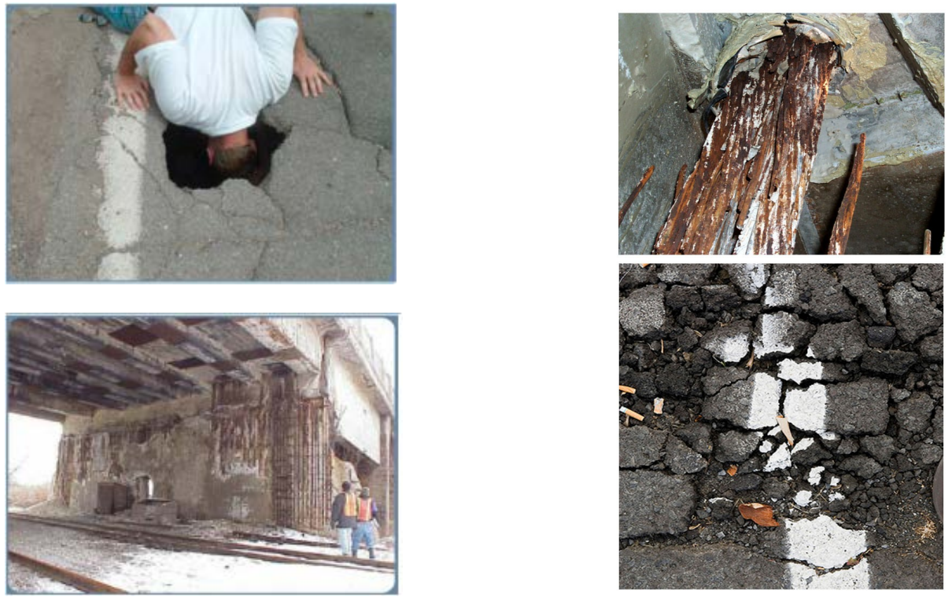
Deteriorating infrastructure

Slide 5
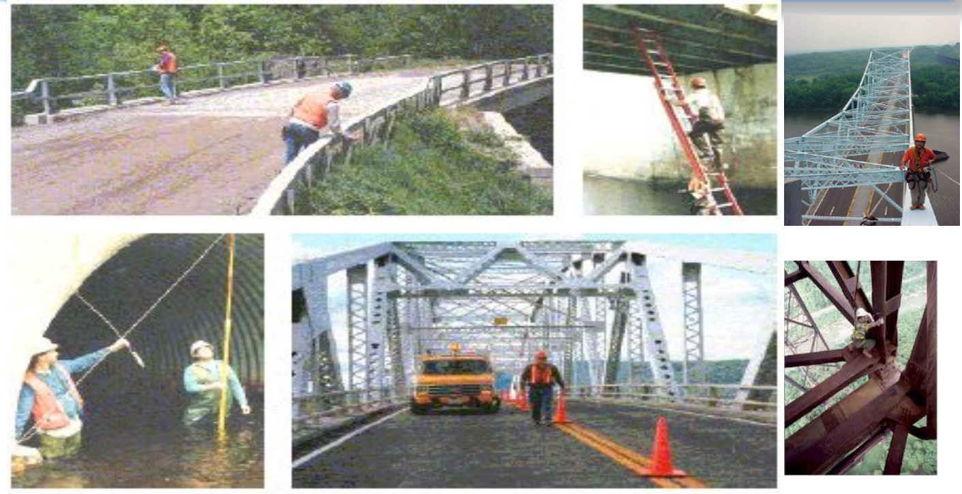
Current inspection practices

Slide 6

STRUCTURAL HEALTH MONITORING system (SHM)
A process of implementing a damage detection and characterization strategy for engineering structures.
Combines IoT, smart sensors and wireless communication technology
Non- destructive in-situ structural evaluation method
Includes installing sensors, data acquisition, data transfer and diagnostics for monitoring and implementation of proper corrective measures.

Slide 7
OBJECTIVES OF SHM
Improve performance and safety of existing structure
An accurate and quantitative analysis of the structure’s conditions and determination of remaining life span of the existing structure by strategic placement of sensors.
Evaluate integrity of a structure post natural calamity/other external factors.
Decline in construction and increased investment in maintenance operations, thus reducing costs
Highly improvised feedback mechanism with data collection on the basis of realistic performance of structures to improve future design
Enhanced safety of workers.

Slide 8
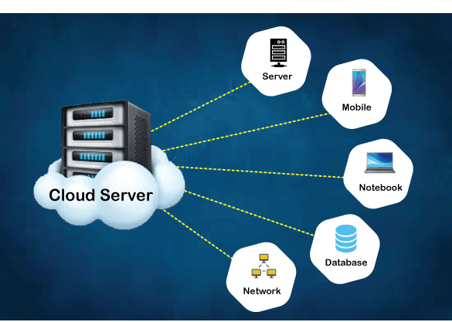
PROTOTYPE SCHEMATIC DESIGN
SERIAL MONITOR (COMPUTER SYSTEM)
UNO
DDATA ACCESS AND MAP API
1 2 3 4 5
6 7 8 9 10
SCADA
Accelerometer
Flex Sensor
3-Axis Anemometer
Camera with Image Processing
Strain Gauge
Load Cell
Temperature and Humidity Sensor
Ultrasonic Sensor
Alarm
Wi-Fi ESP8266

Slide 9
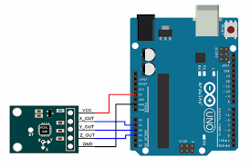
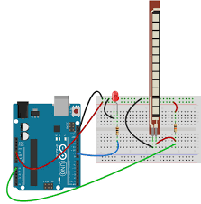
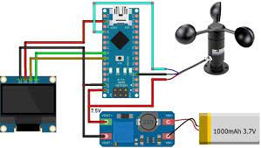
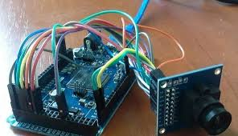
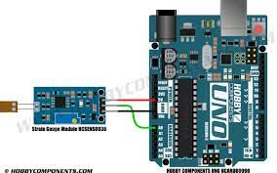
Sensors used
1. Accelerometer 2. Flex Sensor 3. 3-Axis Anemometer
4. Camera with Image Processing 5. Strain Gauge

Slide 10
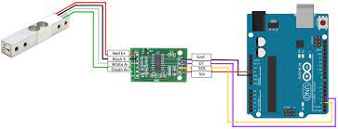

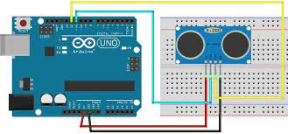
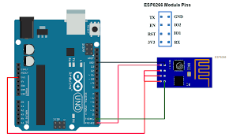
SENSORS USED
6. LOAD CELL 7. TEMPERATURE AND HUMIDITY SENSOR
8. ULTRASONIC SENSOR 9. ALARM SYSTEM 10. WIFI ESP8266

Slide 11
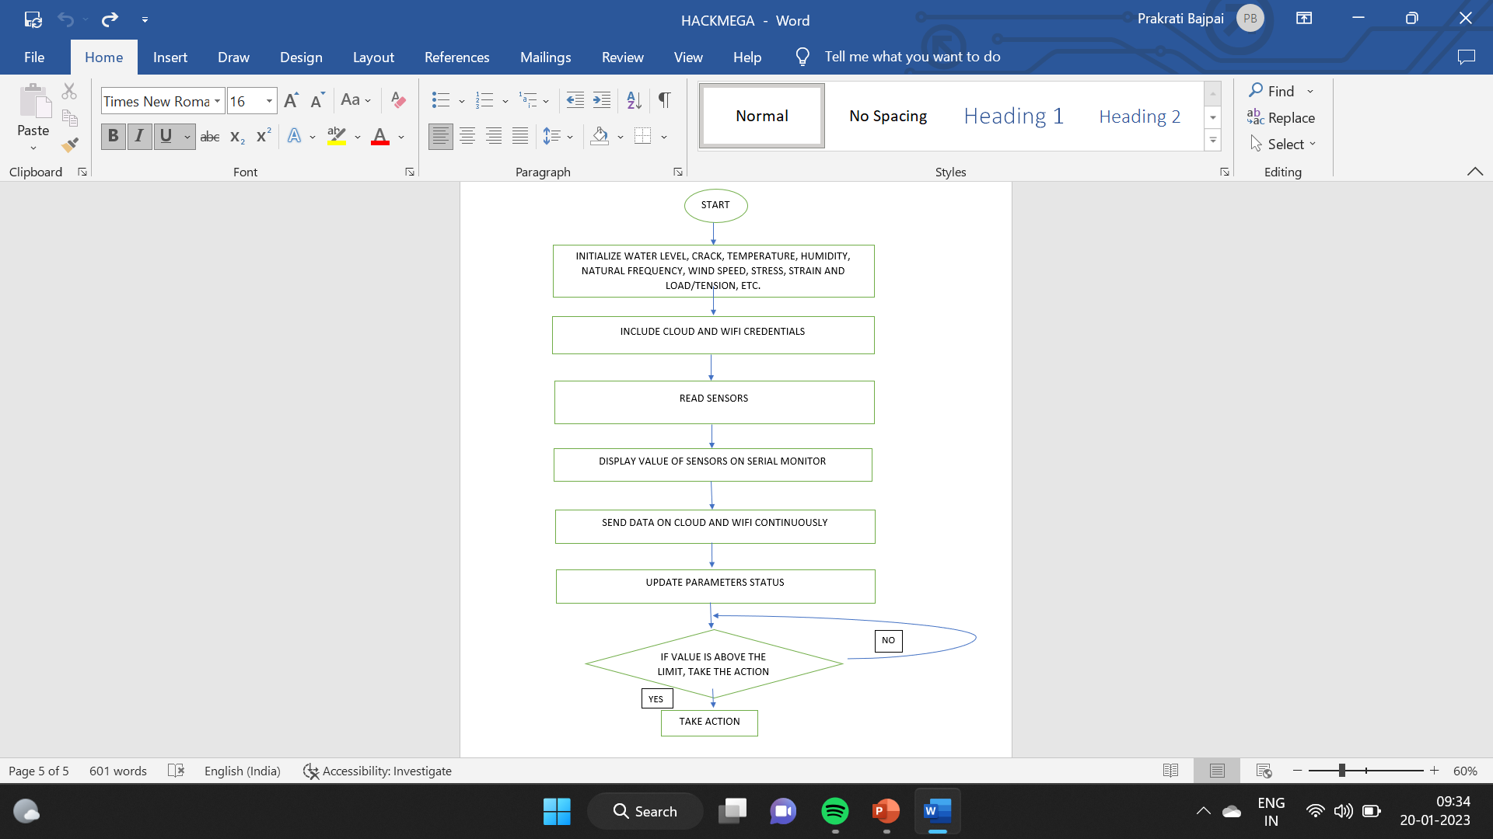
WORKING

Slide 12
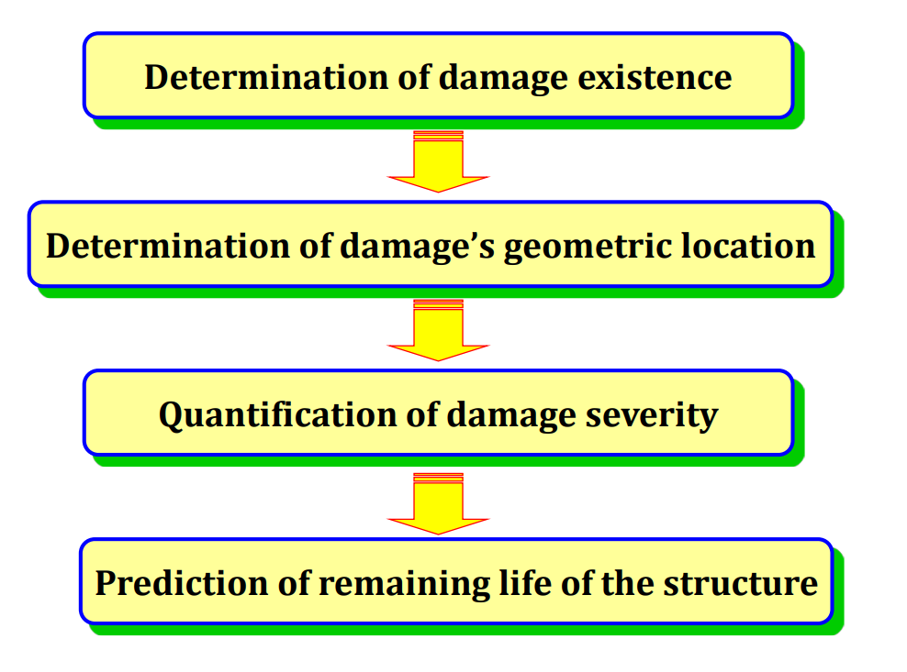
STEPS OF SHM THROUGH (DATA ACQUISITION) MACHINE LEARNING ALGORITHMS

Slide 13
FUTURE SCOPE AND PROSPECTS
In future the prototype of this system can be implemented as various structures like giant walls, other than buildings and bridges which makes it robust, portable and more user friendly than already existing technologies.

Slide 14
THANK YOU !!!

